Slide 1
Impact of Covid-19 on Unemployment in Turkey
Ahmet Arda Yemen Muhammed Ali Kurtuluş
17030411020
17030411033

Slide 2
As we know, covid-19, which affected the whole world, also greatly affected businesses. Affected companies reduced their workforce to reduce their expenses. In this project, we will examine the unemployment rate in Turkey. We will visualize the change in the unemployment rate during the pandemic process.
We get the data for this project from the Turkish Statistical Institution.
After the first case of coronavirus in Turkey, people were affected in many ways. Many businesses and shops lost their revenues after a warning to stay home as a precaution. They tried to reduce their expenses to offset this loss of revenue. The first thing that was done to reduce expenses was to reduce the number of employees. This and such effects have had some effect on the unemployment rate. In this project, it is aimed to visualize the unemployment rate in Turkey after coronavirus.

Slide 3
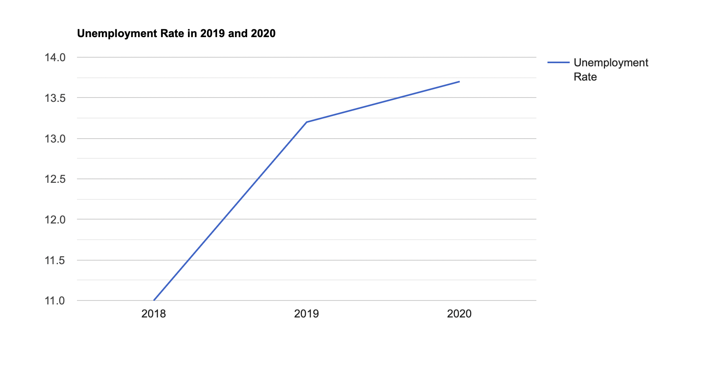
Unemployment, which is one of the biggest social problems for all countries in the global economy, started to cause bigger problems for people with the Covid-19 pandemic. The average unemployment rate in the world is calculated as 10%. In Turkey, the rate is slightly higher than the average. With the effect of the pandemic, this rate has increased to 13.7%.

Slide 4
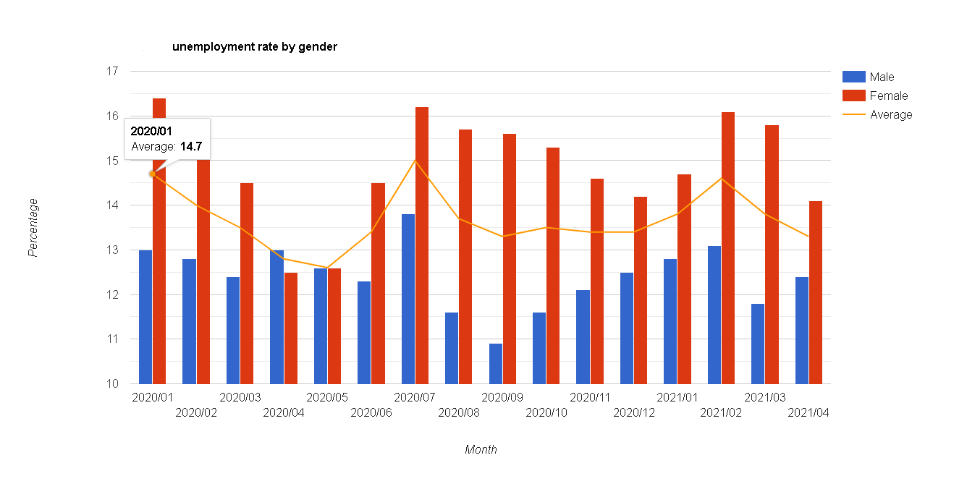
Unemployment Rate by Gender As the wheels of the economy stopped with the pandemic, many people began to lose their jobs regardless of their gender. In Turkey, the female unemployed rate was calculated to be higher than the male unemployed rate. In the Covid period, the unemployment rate for both genders continued to increase.

Slide 5
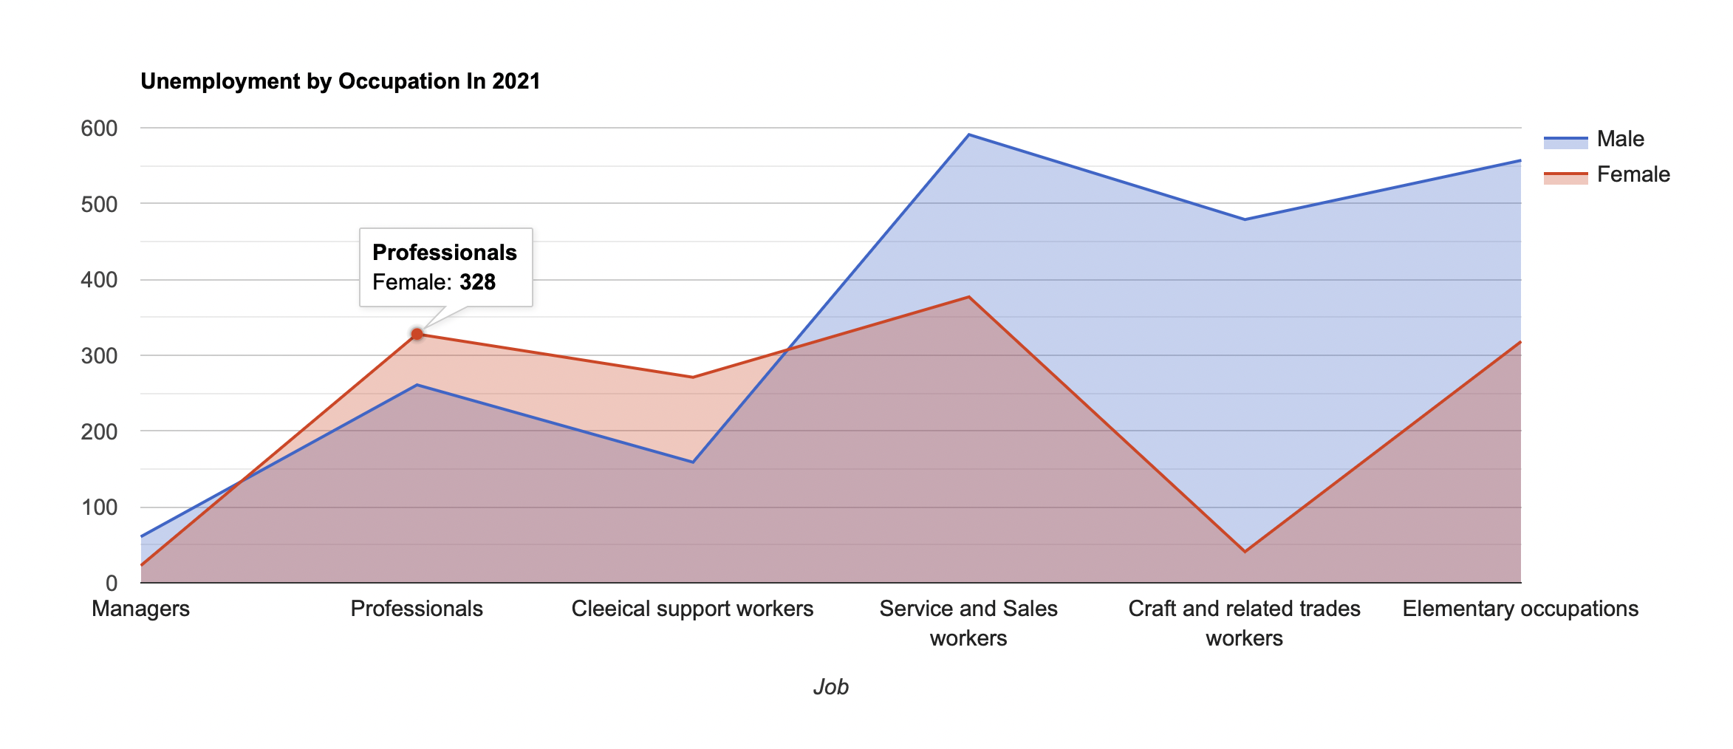
In 2021, when the pandemic is the deadliest and the contagion is at its highest, unemployment rates according to gender distribution of certain occupational groups are shown above, according to the data obtained from the turkey statistical institution. The highest unemployment rate was observed in Service and Sales employees, and the lowest in Management. Contrary to men, the unemployment rate for women in crafts and tradesmen remained low.

Slide 6
In Turkey, people from almost all education levels work in almost all business sectors. With the increase in unemployment rate in parallel with the pandemic, the effect of education level on unemployment rate has become an important statistical data. Contrary to popular belief, the highest unemployment rate was seen among those who graduated from primary school instead of the illiterate. The lowest unemployment rate was seen in the illiterate group.

Slide 7
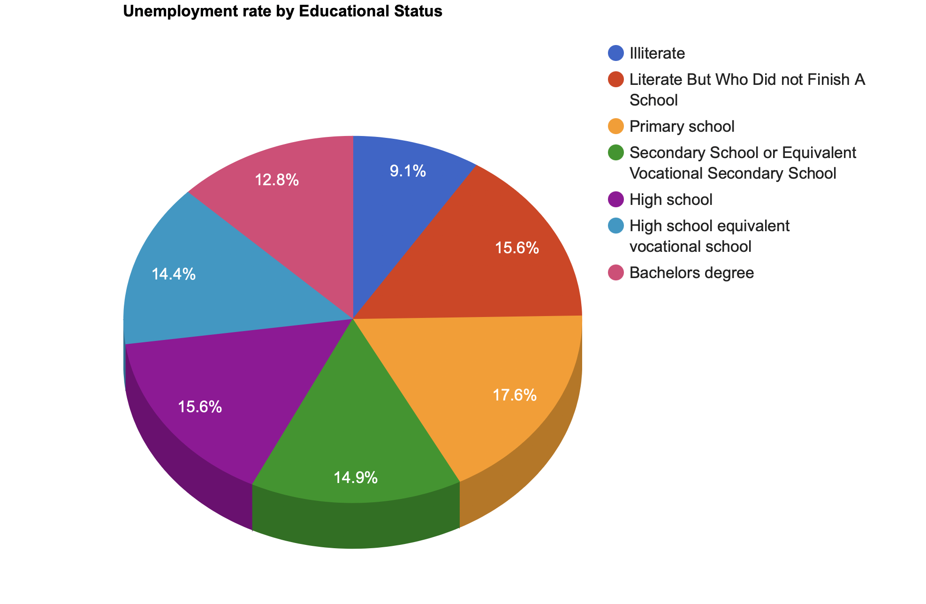

Slide 8
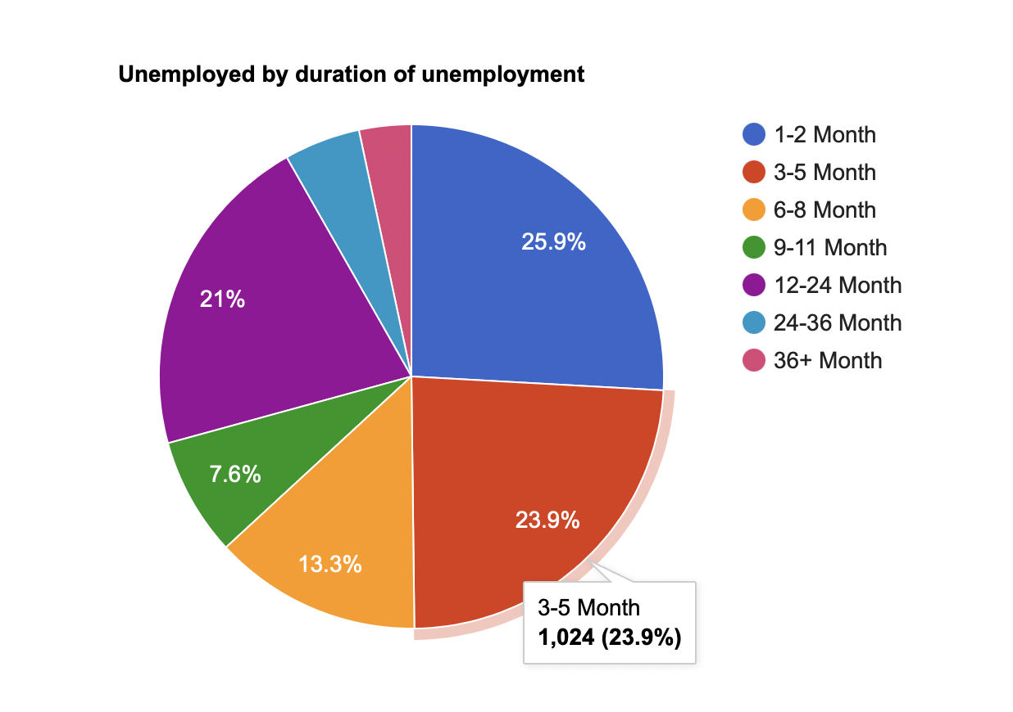

Slide 9
Unemployment according to the duration of unemployment is one of the statistical data that we can see most clearly on the effect of the pandemic process on unemployment. 71% of job seekers are people who have been unemployed in the last 12 months. In other words, people who were unemployed in the process starting from the first covid-19 case in Turkey until today, make up 71% of the total unemployed. This statistical data shows us how effective the pandemic is in people losing their jobs and income. piechart

Slide 10
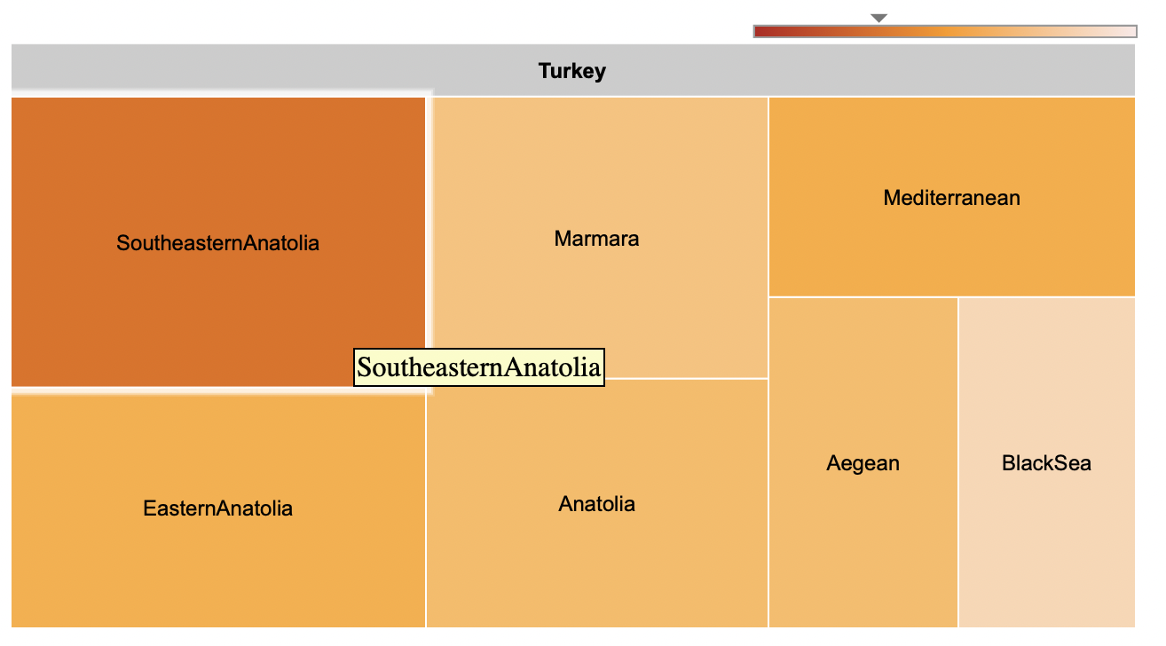
Regions and cities with high unemployment rates are shown in red on our chart, while the color approaches white as the unemployment rate decreases.

Slide 11
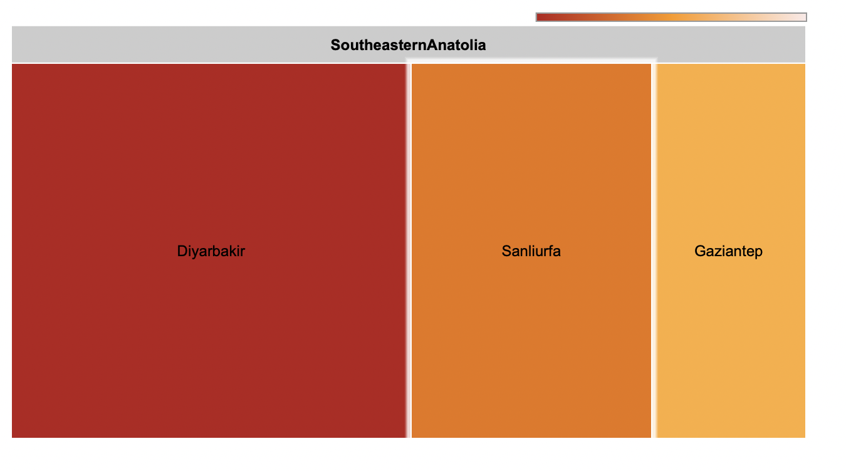
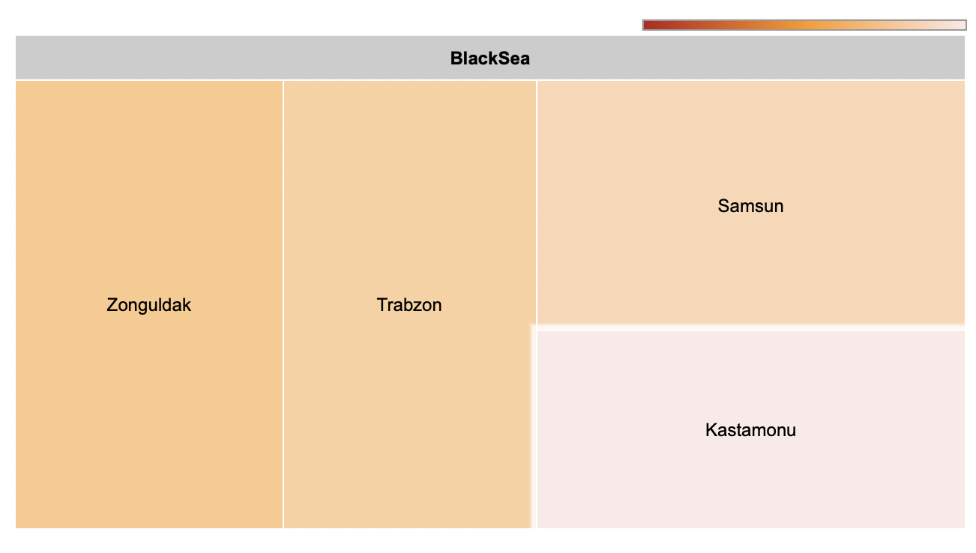
When the unemployment rate in Turkey is divided into geographical regions, it shows quite different rates. The region with the highest unemployment rate is South East Anatolia, and the region with the lowest is the Black Sea region. While Diyarbakir draws attention as the city with the highest unemployment rate, Kastamonu in the Black Sea region is the city with the lowest unemployment rate.

Slide 12
One of the main reasons for the increase in the unemployment rate with the pandemic is the reasons why people do not look for a job, and the statistics of what they are is also available in our presentation. Since there are different reasons for gender, the graph clearly shows the reasons why the male and female workforce do not seek a job. While the biggest reason for women not looking for a job is that they are currently housewives, the biggest reasons for the male population not looking for a job in the workforce are retirement and continuing education. The least common reason is that people can't find a suitable job despite looking for a job.

Slide 13
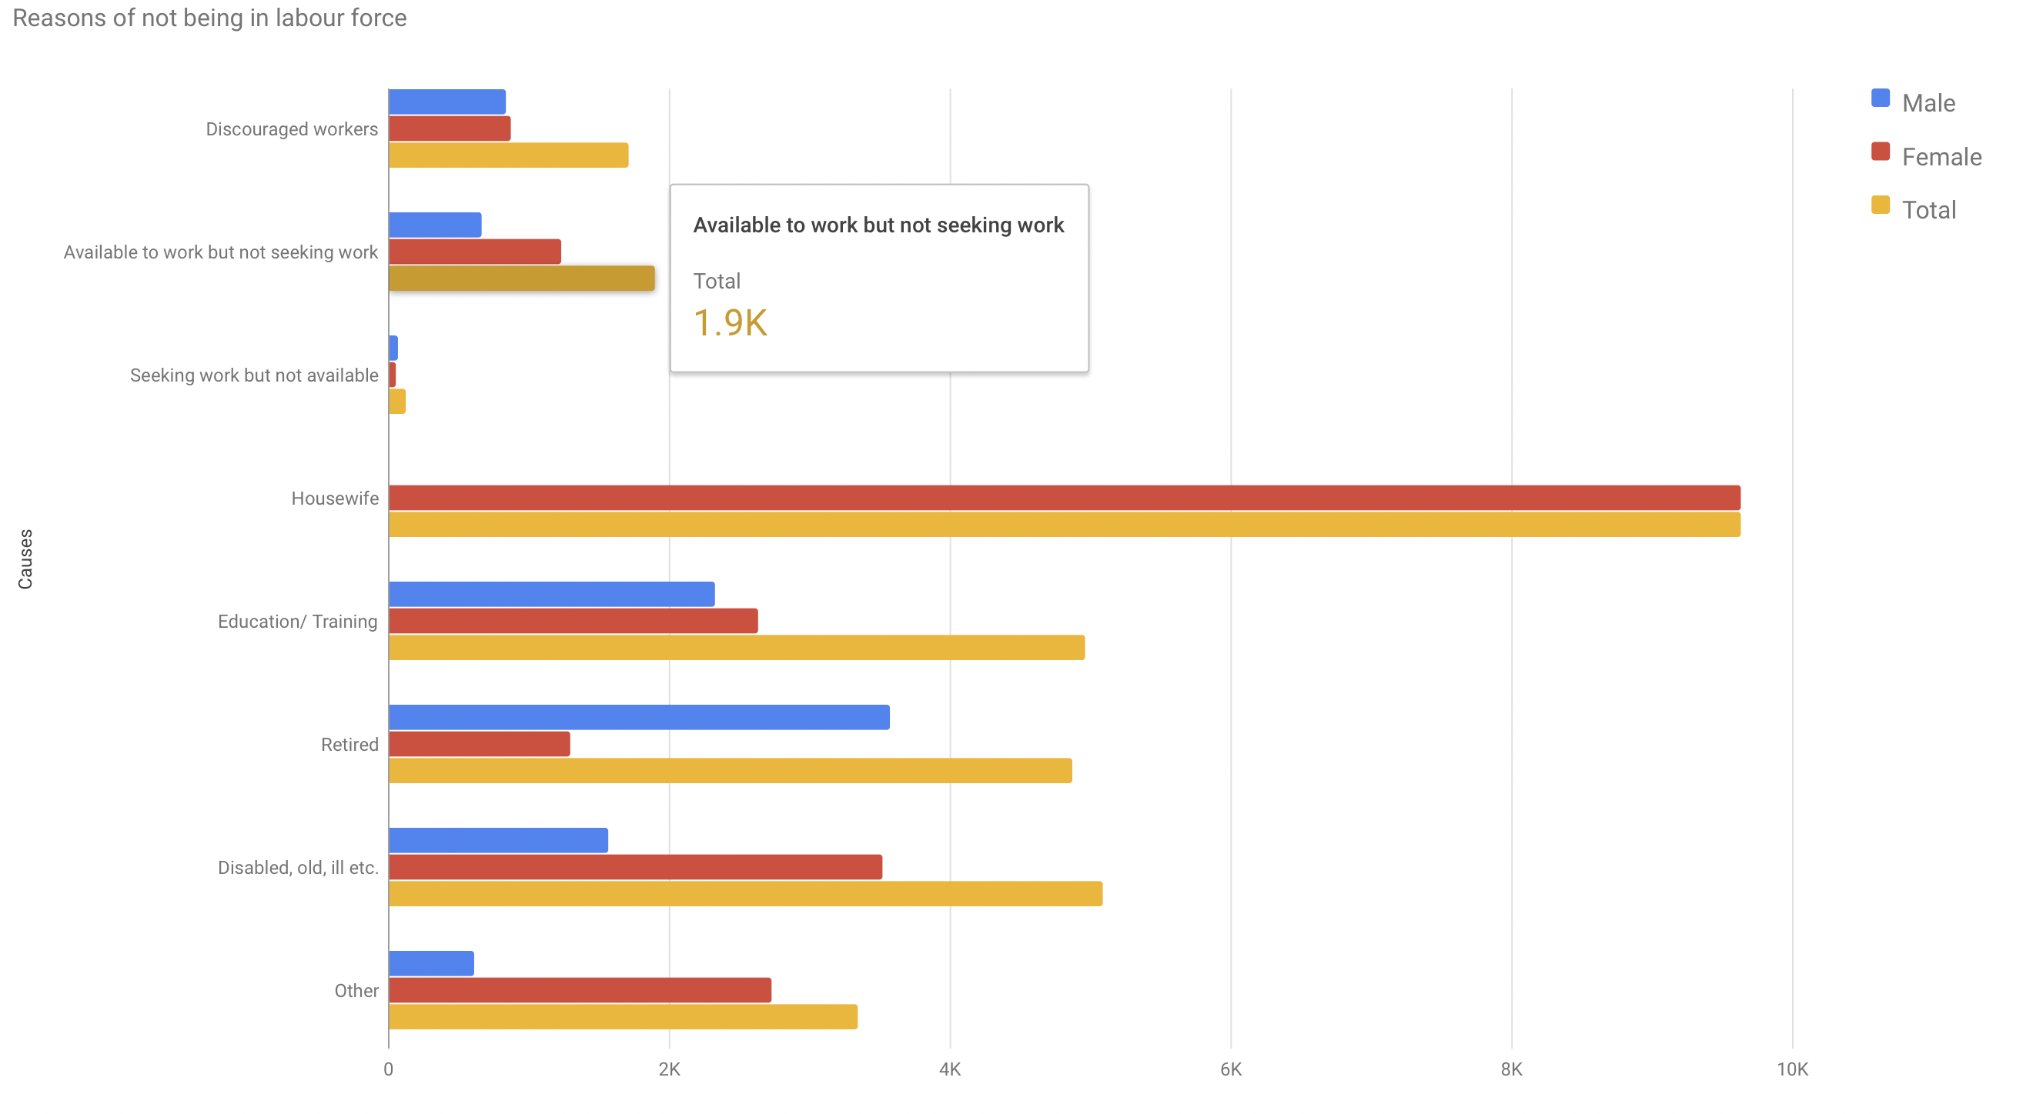

Slide 14
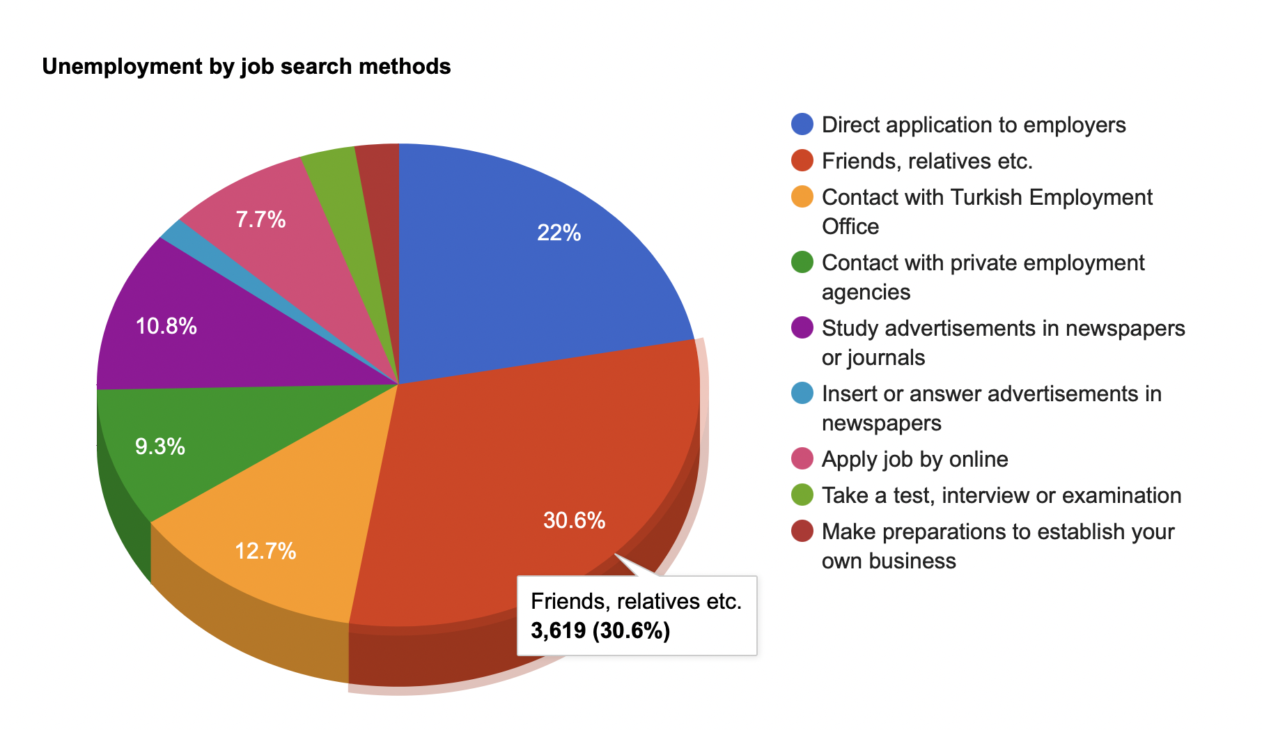

Slide 15
The channels that job seekers use most during the pandemic process; 30% of job seekers search for jobs through their friends and relatives. Secondly, the ratio of the unemployed who applied directly with the employer to the general unemployed is 22%. With the development of technology, the rate of people looking for a job from the newspaper remained at only 1.6%, and newspapers became the lowest job search channel.

Slide 16
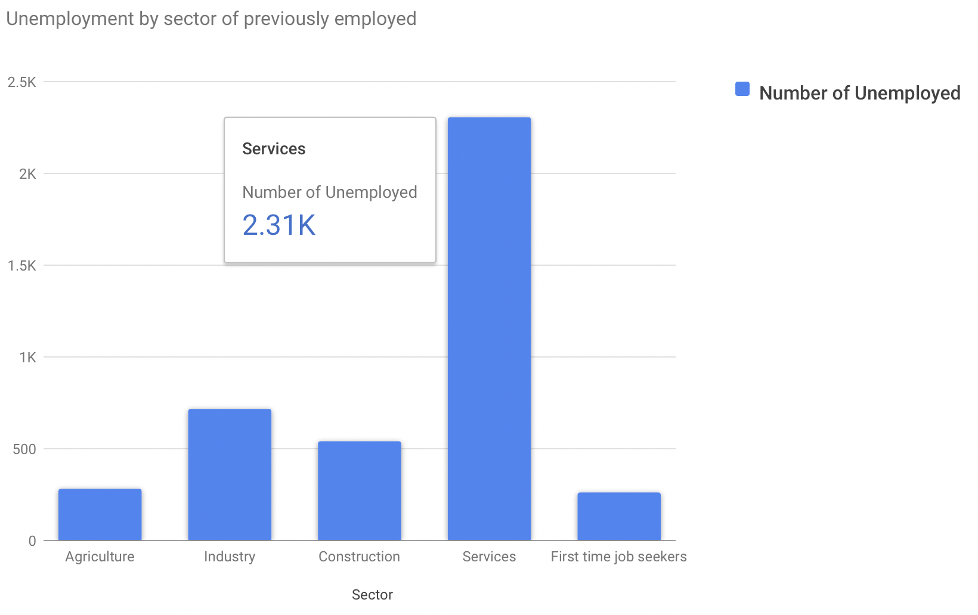

Slide 17
The vast majority of people who lost their jobs during the pandemic were working in the service sector with a ratio of more than 50%. By looking at this graph, we can say that the sector that felt the negative impact of the pandemic the most was the service sector. The industrial sector comes second after the service sector. Almost 25% of those who were unemployed during the pandemic were working in the industrial sector. The sector that was the least unemployed during the pandemic period was the agriculture sector.

Slide 18
In addition to all this information, unemployment rates were increasing not only in Turkey but in almost all countries of the world during the pandemic process. The world map graphic on the next page shows the unemployment rate of many European countries. The country with the highest unemployment rate was South Africa with 25% unemployment rate, while the country with the lowest unemployment rate was China with 4.1%. While Turkey has a rate close to European countries with 13.7%, it has a very high rate compared to Asian countries. In Venezuela, which is in a major financial crisis, the unemployment rate was measured as 8.3%.

Slide 19
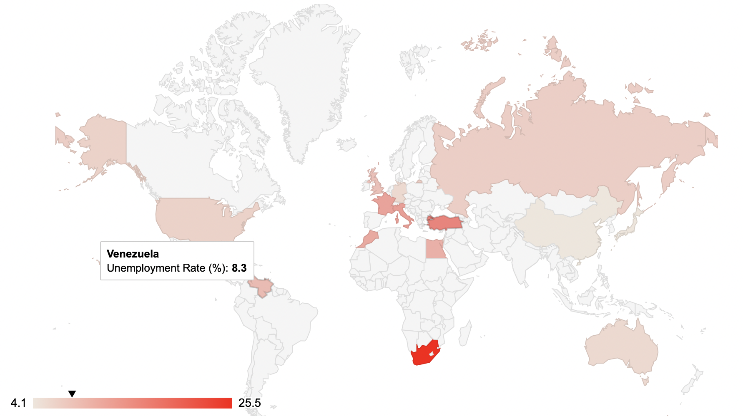

Slide 20
References
https://biruni.tuik.gov.tr/medas/?kn=72&locale=tr
https://cip.tuik.gov.tr/#
https://data.tuik.gov.tr/Kategori/GetKategori?p=istihdam-issizlik-ve-ucret-108&dil=1
https://developers.google.com/chart
https://tr.wikipedia.org/wiki/Ülkelere_göre_işsizlik_oranı_listesi

